Slide 1
INTELLECTUAL PROPERTY RIGHTS
LAUNCH OF MASENO TISC CENTRE AND IP TRAINING
18TH TO 20TH AUGUST 2021
Cleophas Ojode
cleojode@yahoo.com

Slide 2
INTRODUCTION
Intellectual Property (IP) is reserved for types of property that result from creations of the human mind, the intellect.
Three branches of Intellectual Property Rights.
Industrial Property administered by the Kenya Industrial Property Institute (KIPI).
Copyright and Related Rights administered by the Kenya Copyright Board (KECOBO).
Plant Breeders Rights administered by the Kenya Plant Health Inspectorate Services (KEPHIS)

Slide 3
PLANT BREEDERS RIGHTS
Plant Breeders’ Rights (PBR),
Also known as Plant Variety Rights (PVR),
Are rights granted to the breeder of a new plant variety
Gives the breeder exclusive control for a number of years, over the:
propagating material (including seed, cuttings, divisions, tissue culture) and
harvested material (cut flowers, fruit, foliage) of a new variety.

Slide 4
COPYRIGHT AND RELATED RIGHT
COPYRIGHT
Also known in some countries as Author’s right
Copyright relates to:
literary and artistic creations, such as books
music, paintings and sculptures, films and
technology-based works, such as computer programs and electronic databases

Slide 5
COPYRIGHT AND RELATED RIGHT CONT’D
RELATED RIGHTS
Also known as Neighbouring Rights
Related rights protect the legal interest of certain persons or organizations, who either contribute to:
Making works available to the public or
Produce subject matter that does not qualify as “works”, but express creativity or skills sufficient to justify recognition of a copyright-like property right e.g.
Performing Artists
Phonograms Producers
Broadcasting Organizations

Slide 6
INDUSTRIAL PROPERTY
Industrial property takes a range of forms, including:
Patent for inventions of new or improved product or processes.
Industrial Design for aesthetic creations related to the shape or appearance of industrial products.
Trade secret for undisclosed information and know-how. Trade secret is an information and secret which has economic value and industrial application.
Trademark and service mark for words, symbols, pictures, sounds, smells or a combination of these, to distinguish goods and services of one trader from those of another.

Slide 7
INDUSTRIAL PROPERTY CONT’D
Geographical indication for the origin of products.
Layout-designs of integrated circuits for a 3-dimensional configuration of electronic circuits in integrated circuit products.
Protection against unfair competition

Slide 8
PATENT
Definition of a patent
A patent describes an invention for which the inventor claims an exclusive right.
Invention is a new solution to “technical” problem.
It is defined to include any new and useful product or process.

Slide 9
PATENT CONT’D
Any invention which is not protected in a given country, is considered to be in the public domain in that country.
The unprotected invention may be used in the said country for its own technological development without any risk of infringement.

Slide 10
PATENT CONT’D
  A Patent represents a legal monopoly awarded by a government
  In the past, patents were awarded for almost any good or service, for example a patent on salt.
  In modern times, governments award patents for inventions only.
  Most modern patent terms are set at 20 years from the date of the application’s filing.

Slide 11
PATENT CONT’D
A patent confers a time-limited, government-approved monopoly for the invention set forth in the patent’s claims.
This monopoly gives the patent owner the right to:
  Control who makes, uses, sells, offers for sale, and/or imports the patented invention,
  Receive damages for infringements,
  Seek an injunction against further infringement.

Slide 12
PATENT CONT’D
Patent rights are purely territorial (national)
Holding a patent in Country A gives you no right to control what happens in Country B
Patent laws tend to differ from country to country

Slide 13
FILING FOR A PATENT APPLICATION IN KENYA
Four Routes Available
LOCAL (National Patent Office)
ARIPO (Regional IP Office)
PCT (International Office -WIPO)
FOREIGN - DIRECT

Slide 14
EXEMPTIONS TO PATENTABILITY
  Discoveries of materials or substances already existing in nature;
  Scientific theories or mathematical methods;
  Plants and animals other than microorganisms, and essentially biological processes for the production of plants and animals, other than non-biological processes;
  Schemes, rules or methods, such as those for doing business, performing purely, mental acts of playing games;
  Methods of treatment for humans or animals, or diagnostic methods practiced on humans or animals (but not products for use in such methods).
  Inventions that contravene public order or morality

Slide 15
PATENTABILITY REQUIREMENTS
Novelty
  A patentable invention must be new
  Must not be part of prior art or publicly known
  Some countries have strict novelty requirements
    (i.e. absolute novelty)
    Other jurisdictions like Kenya have grace periods where one can still fulfill novelty requirement within one year of an invention disclosure
    Filing of application must precede any public disclosure of the invention

Slide 16
PATENTABILITY REQUIREMENTS CONT’D
Inventive step
Claimed invention must not be obvious to one of ordinary skill in the art.
Invention should be beyond any proper combination of prior art.
Industrially applicable (Utility)
The invention must demonstrate some benefit or positive functionality
  No requirement that the invention must be better than existing products or processes.

Slide 17
ECONOMIC THEORIES BEHIND PATENT LAWS
  Incentive to invent
Encourage inventors to make new creations by giving value to inventions.
  Quid pro quo (Latin phrase meaning ‘something for something’)
Provide protection in exchange for public disclosure.
There is history of inventions “lost” due to secrecy

Slide 18
UTILITY MODEL
A utility model registration provides protection of “minor inventions” through a procedure similar to the patent system
Protects improvements of existing products, which do not fulfil the patentability requirements.
Has less stringent requirements (for example, no or lower level of inventive step),
offer shorter term of protection, 10 years in Kenya.
Designed primarily to respond to the needs of local innovators.

Slide 19
INDUSTRIAL DESIGN
An industrial design may consist of:
Three dimensional features, e.g. the shape of an article or
Two dimensional features, such as patterns, lines or colour.
The design must be applied to an article
Design protection lasts for 5 years but can be renewed to a maximum of 15 years in Kenya.
The owner of a registered industrial design has the right to prevent third parties from making, selling or importing articles bearing or embodying a design which is a copy of the protected design.

Slide 20
INDUSTRIAL DESIGN CONT’D
Products that can benefit from Industrial design
protection
Industrial designs are applied to a wide variety of industrial products and handicraft items:
from packages and containers to furnishing and household goods,
from lighting equipment to jewelry, and
from electronic devices to textiles.
Industrial designs may also be relevant to graphic symbols and logos.

Slide 21
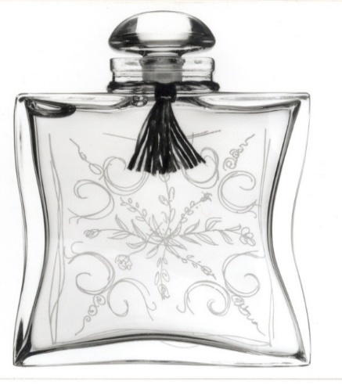
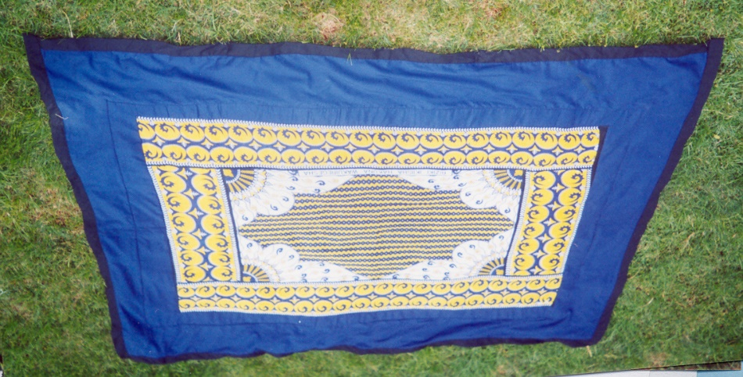

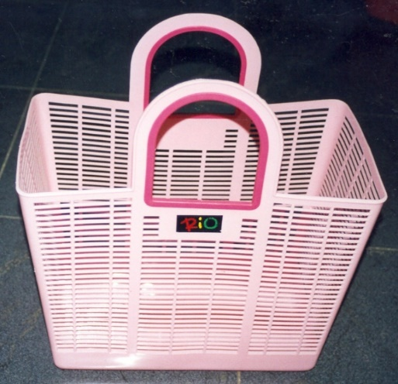
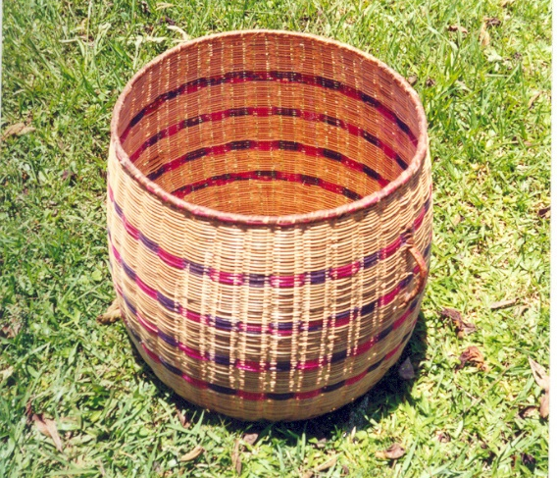
Design examples

Slide 22
TRADE SECRET
What is a trade secret?
Trade secrets are intellectual property rights on confidential information which may be sold or licensed
To qualify as a trade secret, the information must :
be commercially valuable because it is secret,
be known only to a limited group of persons and
be subject to reasonable steps taken by the rightful holder of the information to keep it secret, including the use of confidentiality agreements for business partners and employees.

Slide 23
TRADE SECRET CONT’D
Information protected by trade secrets
Any confidential business information which provides an enterprise a competitive edge and is unknown to others, may be protected as a trade secret
This includes:
technical information, such as information concerning manufacturing processes, pharmaceutical test data
commercial information, such as distribution methods, list of suppliers and clients,

Slide 24
TRADE AND SERVICE MARKS
A trademark is a sign capable of distinguishing the goods or services of one enterprise from those of other enterprises.
A trademark registration will confer an exclusive right to the use of the registered trademark.
A trademark can be exclusively used by its owner, or licensed to another party for use in return for payment.
Registration provides legal certainty and reinforces the position of the right holder, for example, in case of litigation.

Slide 25
TRADE AND SERVICE MARKS CONT’D
How long does trademark protection last ?
The term of trademark registration can vary, but is usually ten years.
It can be renewed indefinitely on payment of additional fees
Kinds of trademarks registered
A word or a combination of words, letters, and numerals
Drawings, symbols,
Three-dimensional features such as the shape and packaging of goods,
Non-visible signs such as sounds or fragrances, or coluor shades

Slide 26


Slide 27
GEOGRAPHICAL INDICATIONS
A geographical indication is a sign used on products
that have a specific geographical origin and
possess qualities or a reputation that are due to that origin.
Geographical indication sign must identify a product as originating in a given place
The qualities, characteristics or reputation of the product should be essentially due to the place of origin.
Geographical indications are typically used for agricultural products, foodstuffs, handicrafts, wine and spirit drinks and industrial products.
e.g. champagne wine produced in the Champagne region of France.

Slide 28
LAYOUT DESIGNS (TOPOGRAPHIES) OF INTEGRATED CIRCUITS
Integrated circuits – commonly known as “chips” or “micro-chips” – are the electronic circuits in which all the components (transistors, diodes and resistors) have been assembled in a certain order on the surface of a thin semiconductor material (usually silicon).
In modern technology, integrated circuits are essential elements of:
Electrical products such as watches, television sets, washing machine
Digital devices such as sophisticated computers, smart phones etc.

Slide 29
PROTECTION AGAINST UNFAIR COMPETITION
What is unfair competition?
Unfair competition is any act or practice carried out in the course of industrial or commercial activities contrary to honest practices.
May include acts or practices like
causing confusion,
damaging goodwill or reputation,
misleading the public and
the use of secret information.

Slide 30
REASONS FOR PROTECTING IPR
To prevent imitation or copying
To send a signal to the market about the product
To avoid wasteful investments in Research & Development by consulting patent database
To increase market share
To get protection in overseas markets
To get access to new financing opportunities
To increase the market value of the organization
To enhance the reputation of the organization
To create a corporate identity through a
trademark and branding strategy

Slide 31
END
THANK YOU FOR LISTENING

